Slide 1

The Correlation between Walkability and Happiness
Python B Final Project
Vir Kapoor and Layla Elnasser

Slide 2
Outline
01
02
03
04
Data Analysis
Significance
Visualizations
Conclusions

Slide 3
01
Significance

Slide 4
Significance
Walkability is defined as the ability to safely walk to services and amenities within 30 minutes or less.
Benefits of increased walkability include:
Increased accessibility
Improved physical health
Decreased environmental impact
Despite all the numerous studies looking into these benefits of more walkable cities one impact is often overlooked, emotional wellbeing. Therefore, we wanted to further looking into this metric and see if there is a correlation between the two with our research question being:
Do more walkable cities correlate with better emotional wellbeing of residents?

Slide 5
Data Selection
In order to calculate if there is a correlation, we needed two sets of data:
Walkability scores amongst US cities
Emotional happiness scores amongst US cities
In order to answer this magnitude of a question we needed to ensure our samples were a representative fit of the entire population. Therefore, we decided to only choose cities with a population of above 200,000+ people. Additionally, we had to ensure our sources were reliable, so we would not be presenting false data with incorrect correlations.
Data Sources used:
https://www.walkscore.com/cities-and-neighborhoods/ published in National Institute of Health
https://wallethub.com/edu/happiest-places-to-live/32619 cited hundreds of times

Slide 6
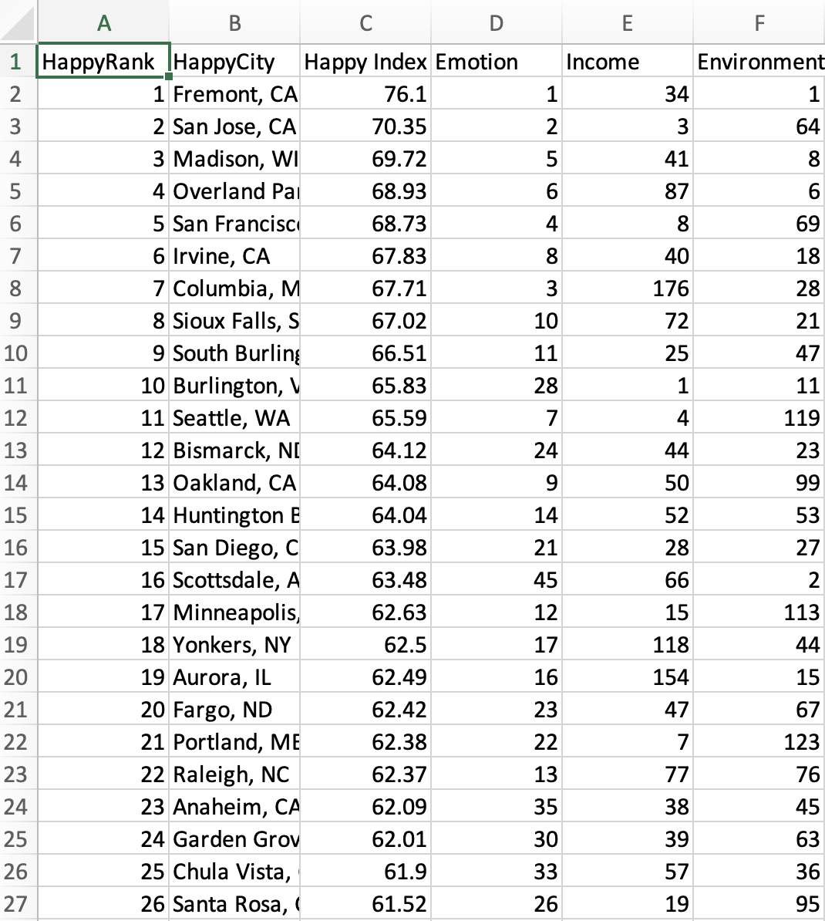
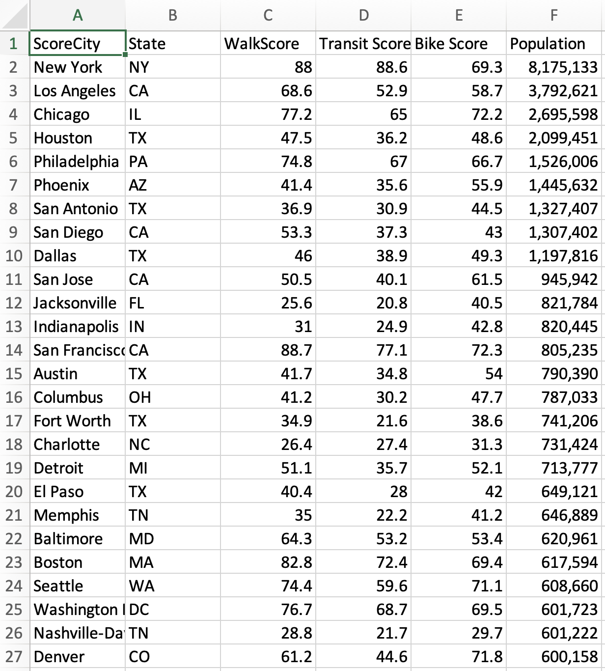
Happiness Scores Data Set
Walkability Scores Data Set

Slide 7
02
Data Analysis

Slide 8
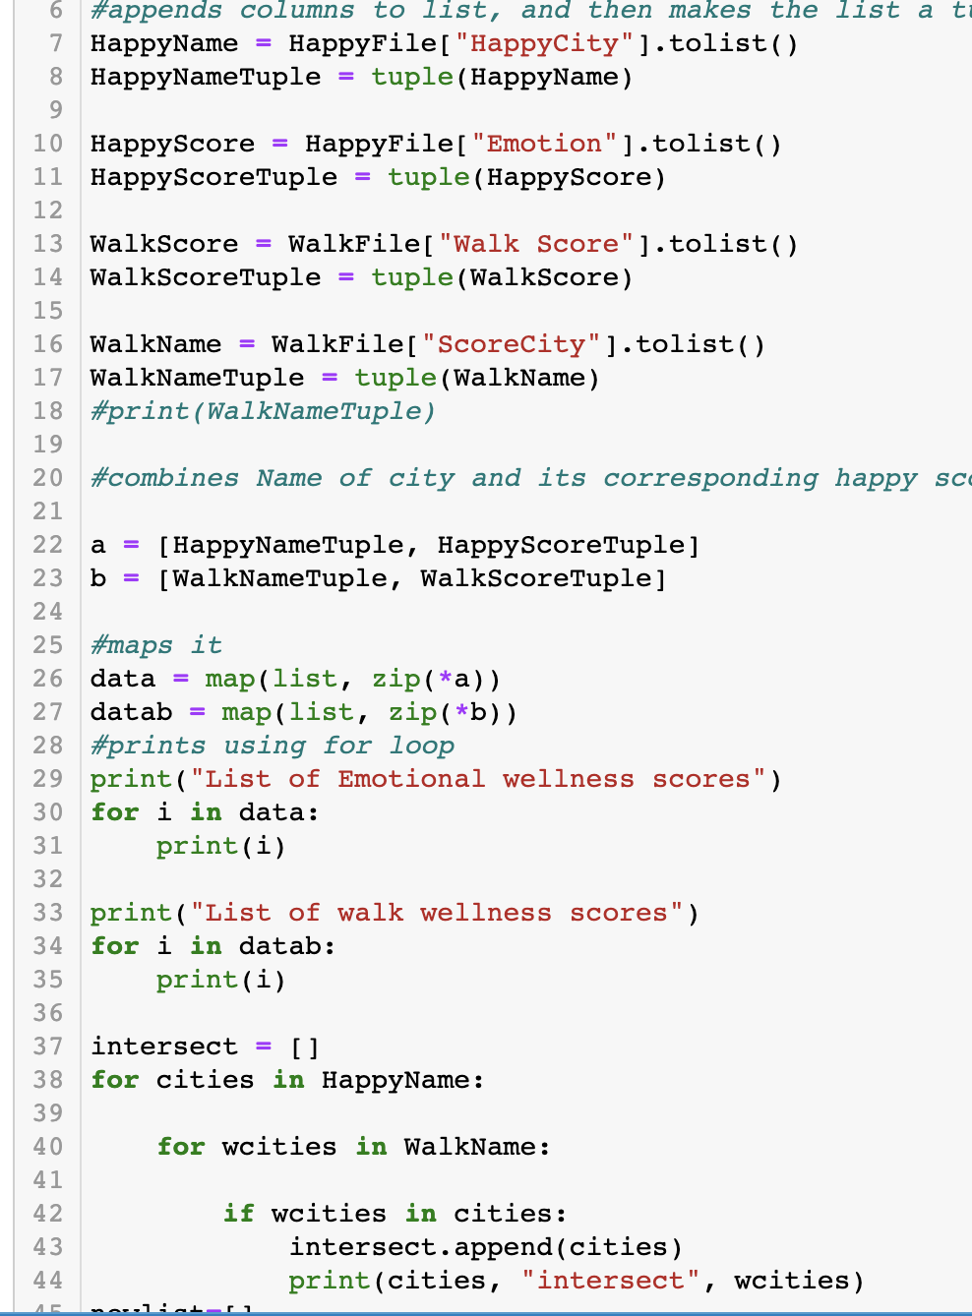
Storing the Data
Originally, we stored the walkability scores and emotional scores to multiple tuples and then mapped them to various lists.
While this worked, it was not efficient and confusing to keep track of variables. Additionally it would be difficult to get all these tuples separated and use their data for the visualizations.
So instead we changed our code to …

Slide 9
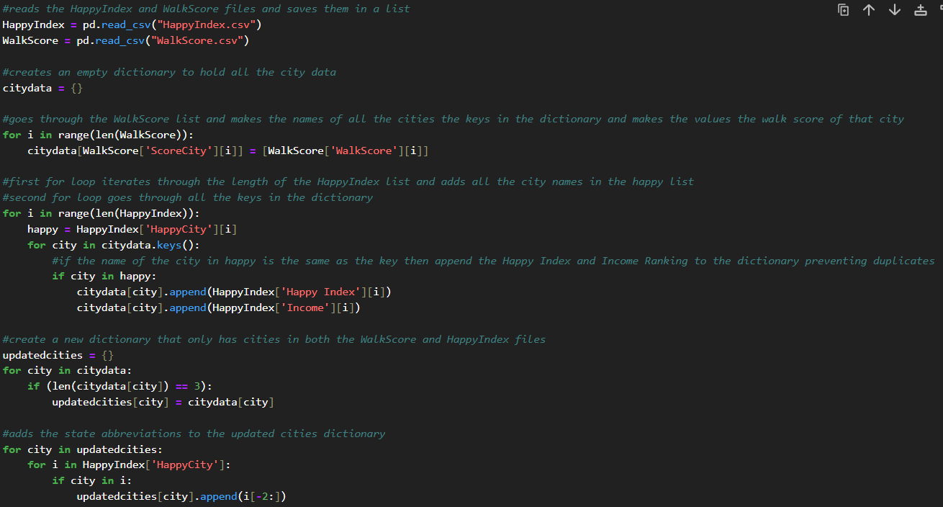
Storing the Data Cont.
This code went through the data sets and converted it into a dictionary with the cities as the keys.

Slide 10

Then, it iterated through the values and created separate lists for them making it easier to create the graphs.

Slide 11
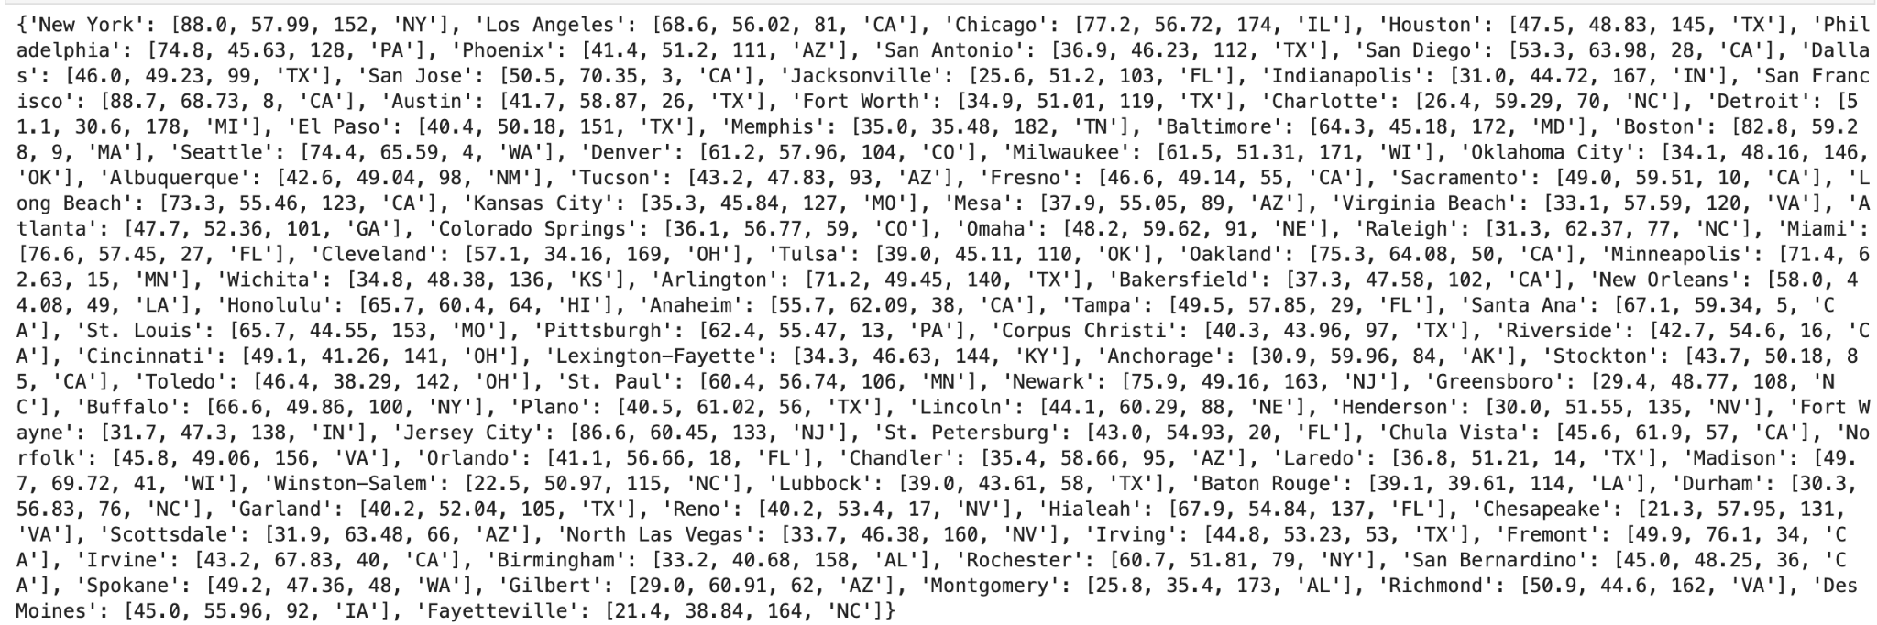
Sample Output:

Slide 12
03
Visualizations

Slide 13
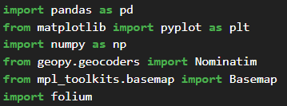
Libraries
This is a photo of all the libraries we imported within our code to make all of the graphs and visualizations:
Pandas: We included pandas to read all the data from the csv files and create dataframes.
Matplotlib: We used matplotlib for graphing all our data and lines of best fit within those graphs.
Numpy: We added numpy to make the lines of best fit and find the outlier points.
Geopy: Geopy enabled use to make the interactive map which had all of the cities in labeled.
Basemap: With basemap we were able to take a map of Florida and plot our cities on to it.
Folium: Through folium we were able to make customizations to our interactive map.

Slide 14
Displaying the data
Originally, when picking how to display our data we chose to make graphs because graphs can be easily interpreted and visually display correlation amongst data sets. We originally wanted to make 3 graphs for this presentation:
Graph of happy index vs walkability
Graph of walkability vs income ranking
Graph of happy index vs income ranking
However, after we made these three graphs we decided we should also have some different visuals in order to analyze correlations within the state and country. Thus, we decided to make some maps because the best way to visualize geographic information is within a map. The maps we chose to make were:
A fixed map of Florida with the cities labeled.
A interactive map of America with all the cities in the dataset labeled.

Slide 15
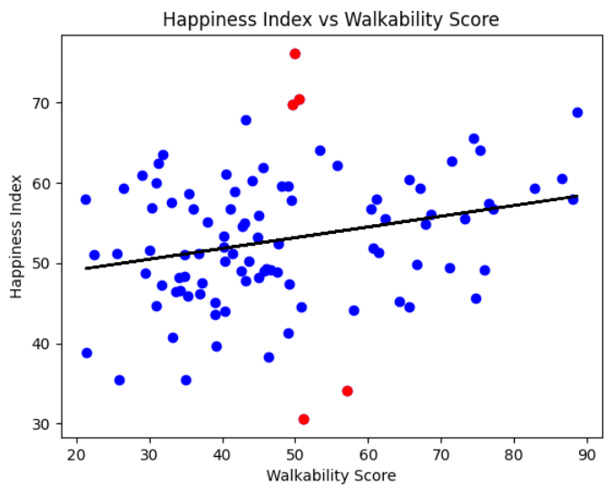
There is a positive correlation between higher walkability and more emotional happiness, albeit there are some outliers as expected.

Slide 16
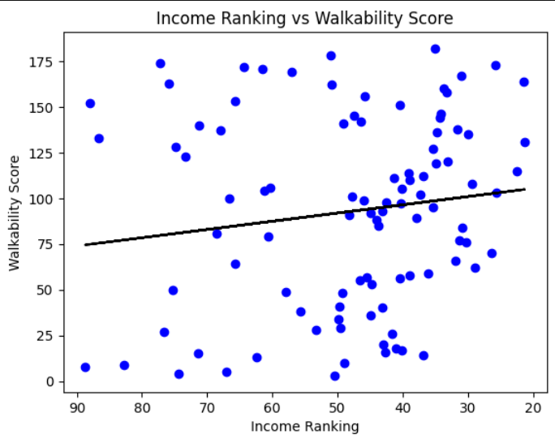
Higher incomes correlate with more walkability, and lower incomes tend to have less walkability. In order to create this visualization, it was necessary to invert the x-axis because lower incomes have a higher ranking, and vice versa. For example, a region ranked #1 would have the highest income, whereas a region ranked 90 would have the lowest income).

Slide 17
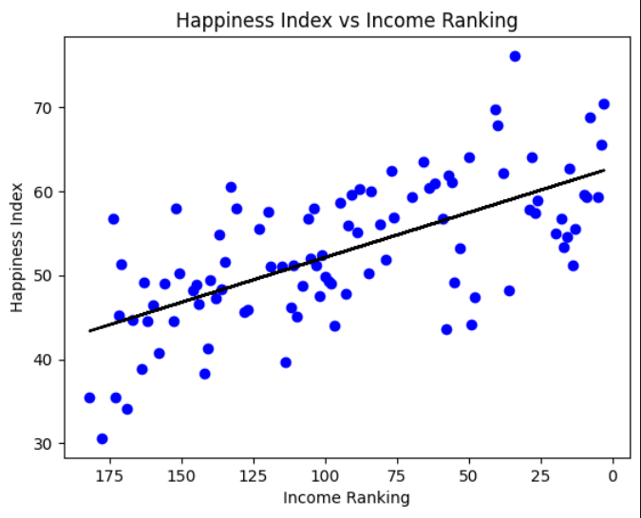
There is strong correlation between income ranking and happiness, where higher income regions tend to have more happiness. It was necessary to invert the income x-axis as lower incomes are represented by higher rankings (ranking #1 having the most income and ranking #175 having the least).

Slide 18
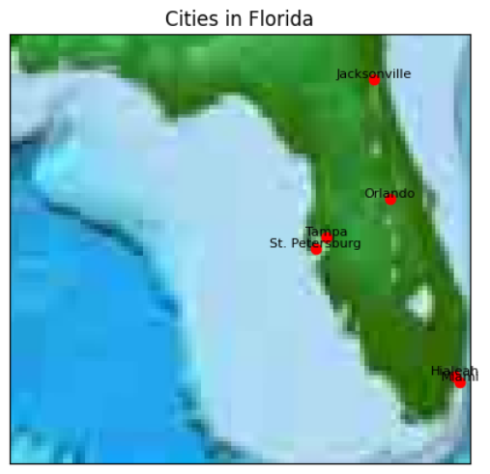
This map displays six cities in Florida with the highest correlation between their happiness index and walkability score. Unfortunately, the maps ended up blurry because our computers do not have enough computing power for higher resolutions.

Slide 19


Slide 20
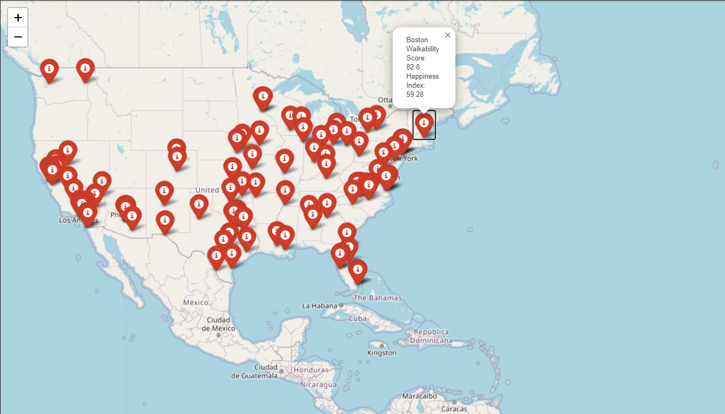
This map displays all the cities in our data set. If we open the code we can see that this map is interactive and we are able to select different cities that are labeled and obtain more information about their walkability and happiness index.

Slide 21
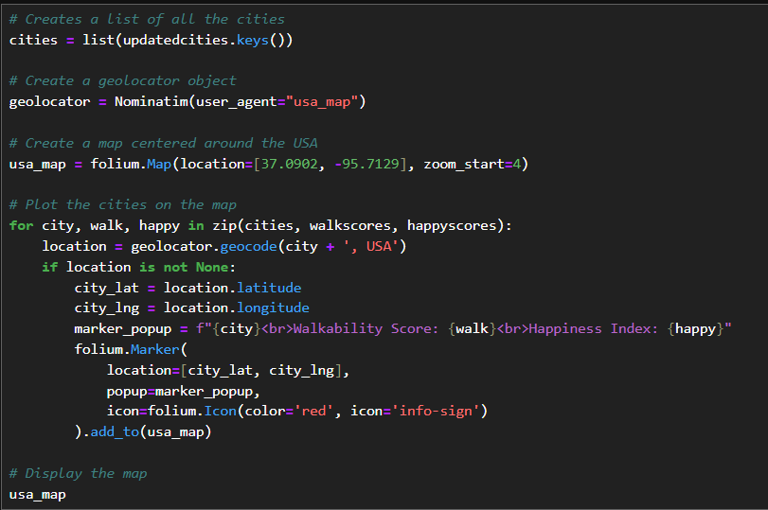

Slide 22
04
Conclusion

Slide 23
Analyzing outliers
Detroit, MI has a walkability score of 51.1, but a strikingly low happiness score of 30.6.
Through research, this can be attributed to poor city management by the government and extreme poverty, causing decreased social services and higher crime.
Thus, its relatively decent walkability does not seem to positively influence happiness as expected.
Fremont, CA has a walkability score of 49.9, but a happiness score of 76.1!
Fremont is in the heart of silicon valley, so it is more likely that they were able to get more data samples as people there are more familiar with technology.
Fremont has large valleys which are enjoyed for their natural beauty, but they make it harder to access walkable services. Nevertheless, being the happiest city in the USA, this doesn't seem to affect its happiness scores.
Cleveland, OH has a walkability score of 57.1, but a happiness score of 34.16.
Cleveland is deemed as the most stressed out city in the USA, being rated high in financial and familial stresses.
Regardless of Cleveland being relatively walkable, these stresses factor into the lower happiness rating.
Understanding why certain cities do not match our line of best fit helps us understand the dynamics between walkability and emotional happiness.

Slide 24
Interpretations
Ultimately, the analysis of walkability and happiness scores across the United States shows that there is a positive correlation between higher walkability and more happiness.
However, the strength of this correlation becomes weaker due to outliers that greatly exceed the best line of fit, such as the ones analyzed in the previous slide.
Positive correlation is found between higher income and happiness.
Walkable cities tend to have more income.
Only looking at the data within Florida does not show a correlation between relative geographic location and walkability, but looking at a larger scale of the USA shows that more walkable cities tend to be on the East coast.
There is also less data for the midwest, which makes sense as cities typically do not exceed 200,000 within these regions.

Slide 25
Moving Forward and Progress
UItimately, this project was a great opportunity to practice using various data visualization packages and work with data processing in Python. We both have learned a great amount about working with computing large sets of data and making statistical inferences from it.
To further develop this project, including broader data sets with cities outside of the USA would be critical in order to make better statistical inferences. Data sets tend to be western focused, causing inferences in research to be biased towards the west. By including more broad data, a more holistic understanding of walkability versus happiness could be derived. This is especially crucial because cities within Europe and Asia tend to be smaller and more densely populated, causing cities to intrinsically have walkable landscapes.

Slide 26
Picture resources
https://www.nicepng.com/png/detail/19-190505_jpg-royalty-free-download-city-png-transparent-images.png
Walkability definition:
https://www.strongtowns.org/journal/2016/2/22/why-walkability?utm_term=&utm_campaign=zOLD:+Strong+Citizens&utm_source=adwords&utm_medium=ppc&hsa_acc=3331407718&hsa_cam=396253116&hsa_grp=27903541716&hsa_ad=548565099266&hsa_src=g&hsa_tgt=dsa-19959388920&hsa_kw=&hsa_mt=&hsa_net=adwords&hsa_ver=3&gclid=CjwKCAjw5MOlBhBTEiwAAJ8e1uRIwaqPV2BI6nR2qWCRFXW88YSh2VkvdbuJvQUaTiuM03UY9YDvORoCBagQAvD_BwE

